Slide 1
Press Play To Repeat
A game about Dementia
By Jay Miller

Slide 2
Plot
An old man living alone after his wife’s death is suffering from severe dementia.
He’s going through a regular week in his life.
As the days go on he starts to forget where things are and what tasks he’s done during the day.
When he’s getting to the end of the week he starts to forget who his family is and what he needs to do in the day.

Slide 3
Summary
You play as an old man living with severe dementia.
As the game progresses tasks are repeated one after another to simulate what it’s like to live with dementia.
This simulation is aided by audio and dialogue scattered throughout the days.

Slide 4
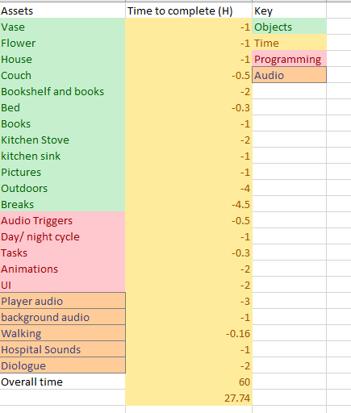
Asset list
List of assets needed to complete the build.
Time to complete measured in hours.
Allotted extra time for breathing room and catch up.
Final time left for error, polishing and catching up is 27.74 hours.

Slide 5
Week 1 milestones
Rough outline of Vase, Bed and couch.
Start grey boxing the outdoor area.
Rough grey box of house and outdoor area.
Stove and sink grey box
Vase, bed and couch completed.
Bookshelf, Flowers, pictures and house grey box finished
Outdoor assets grey box

Slide 6
Week 2 Milestones
Audio trigger script made
Task script made
Start contacting people for dialogue purposes.
Polish art assets
Find and implement walking audio
Find and implement hospital audio
Implement UI
Create 1 full playable day

Slide 7
Week 3 Milestones
Create day 2 and implement colour fading on some objects.
Polish day 2 and start day 3 with more colour fading until some objects appear grey.
Implement dialogue
Final polish

Slide 8
Scope
Originally there were 7 playable days but due to time constraints now there are 3.
The playable days are now day 3, 4, 5 from the original 7.
These days were chosen to showcase the progression of the dementia.
Levels will be 5-10 minutes long depending on how the player navigates the level.

Slide 9
Prototyping techniques
Story Board: I used the story board to plan out the full 7 days of gameplay. I then iterated and only used days 3, 4 ,5
Mind Map: I used the mind map to help plan out what I was going to use in my levels and what assets I needed to make.
Beat Sheet: the beat sheet helped me plan my levels and give them more structure.

Slide 10
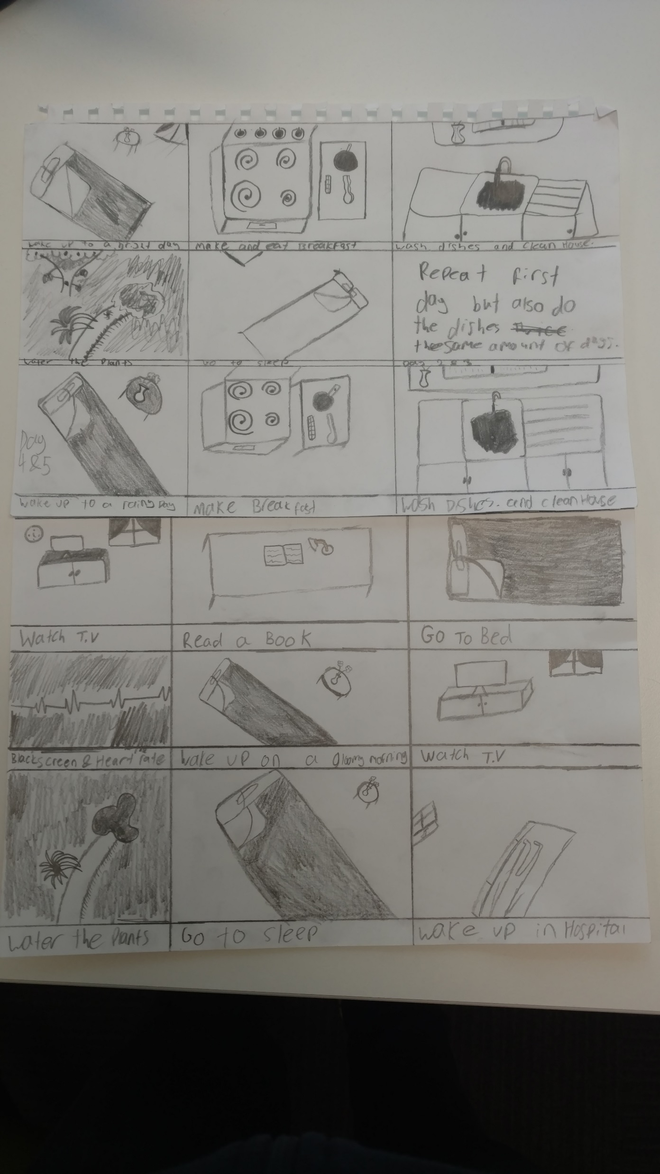
Story board

Slide 11
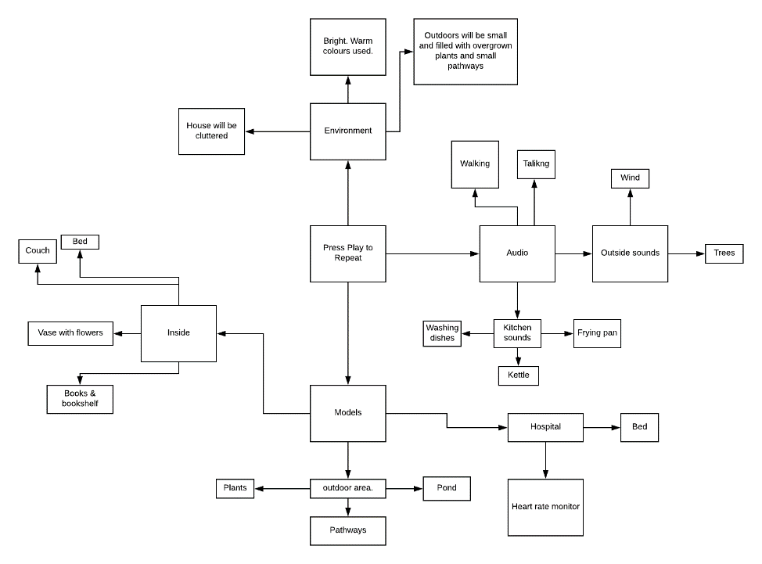
Mind Map

Slide 12
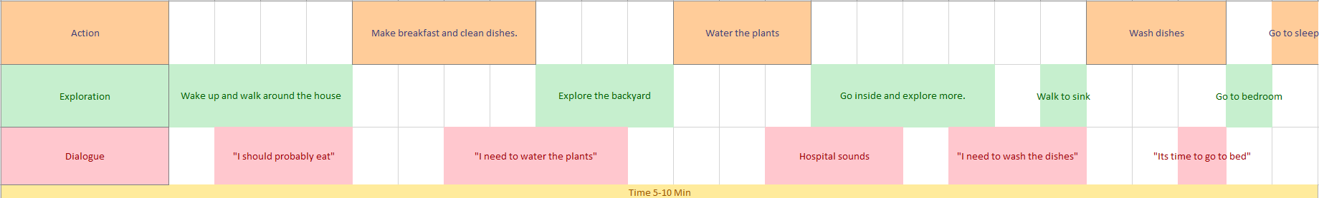
Beat Sheet

Slide 13
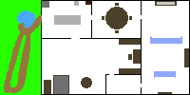
Map of playable area

Slide 14
Questions?

